Slide 1
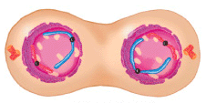
MITOSIS
Decentralized, self-healing and regenerating systems for managing IT infrastructure

Slide 2
Problem
Centralized systems will not be able to keep up to the rising complexity on the IT world.
Keeping and maintaining the state of the entire system to become increasingly harder and eventually impossible.

Slide 3
Solution
Fully decentralized environment where separate agents are following simple rules for self healing and communicating with sibling agents.
Additional complexity will emerge from the behavior of the agents

Slide 4
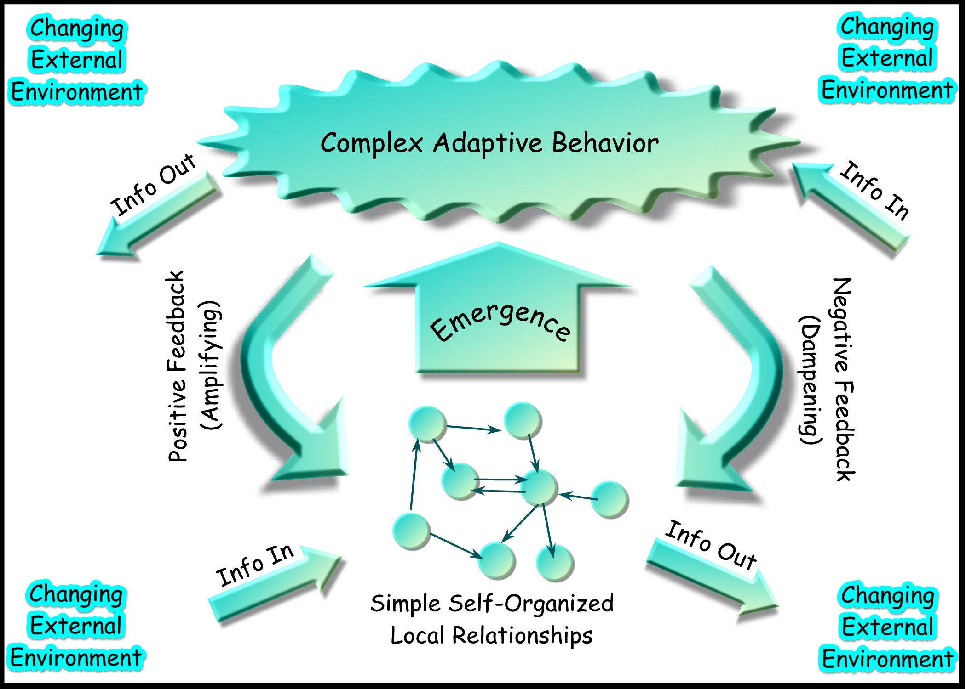
Complex Adaptive Systems
﻿

Slide 5
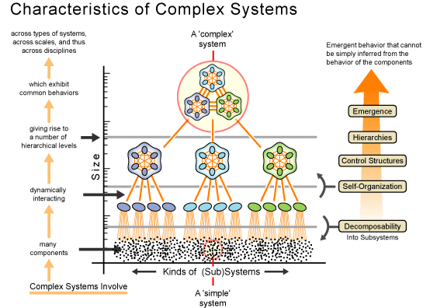
Emergence

Slide 6
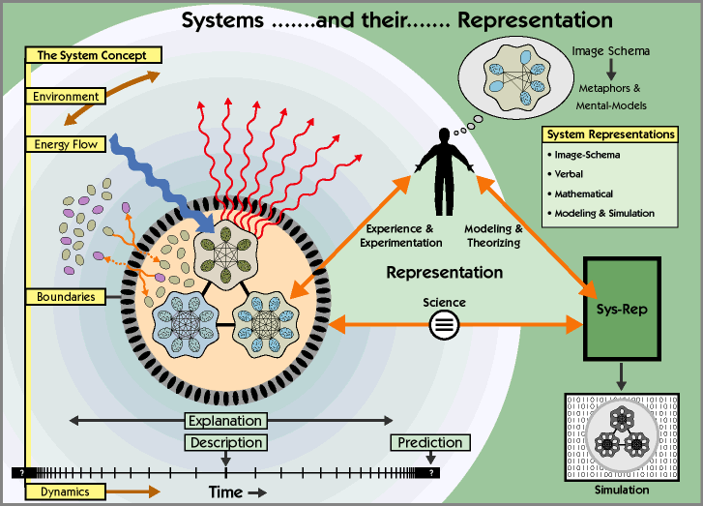
Complex systems

Slide 7
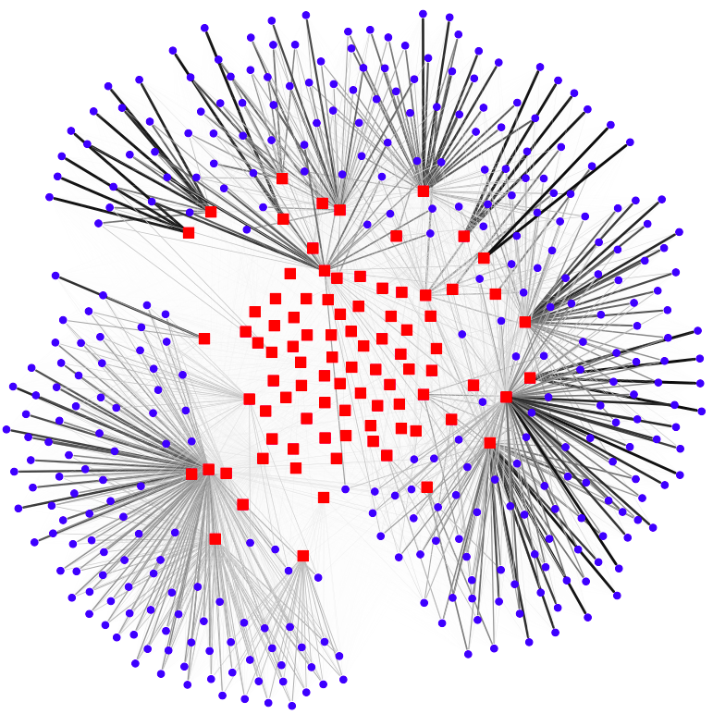

Slide 8
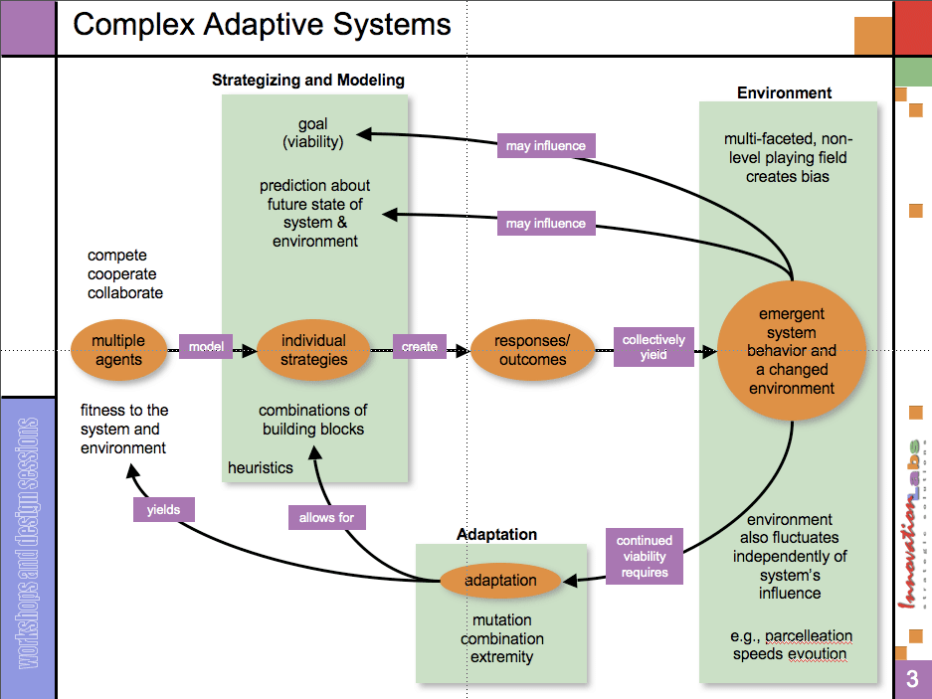

Slide 9
Archetecture

Slide 10
Automatic Prioritization Of Services for Efficiency (1)
Webserver Store Front
Load balancers
Webserver Support
Database Store
Online Payment
Test Site
Webserver Store Front
Load balancers
Webserver Support
Database Store
Online Payment
*)Request a demo for live demonstration

Slide 11
Automatic Prioritization Of Services for Efficiency (2)
Webserver Store Front
Load balancers
Webserver Support
Database Store
Online Payment
Test Site
Webserver Static Store Front
Load balancers
Online Payment
*)Request a demo for live demonstration

Slide 12
Comparison
Master / Slave
Mitosis
Complexity of Master grows as system size increases
All possible future states of system needs to be defined in this approach
All information of system state must be understood by one single master
Single point of failure
Over usage of resources to compensate for unpredictability
Complexity is local only to agent and thus does not grow as system grows
Only local future states need to be predicted, i.e. not system wide
System can be elastic on each functional level separately
Single node can rebuild entire system. This is opposite of single point of failure
Efficient use of resources. Easily move between (cloud) providers. Prioritize in case of stress.

Slide 13
Features
Self-healing simple agents able to communicate and (re)grow full system based on the DNA of the system
Complex behavior on the system level emerging from the behavior of the separate simple agents
Information synchronization between hosting environments
Market for trusted agent images
Simulation of variety of possible future states

Slide 14
Future Development
Running on multiple hosts
Using multiple cloud providers including easy migration
Improved security of the system
Plugins based design for developing smart agents

Slide 15
Main Benefits
Resilience of the system
No one holds the full state of the system
Recreate the full system from a single agent
Efficient use of resources
Less overprovisioning
Easy migration between platforms

Slide 16
Business Model
Free open source version
Commercial support and trainings
Hosted services
Commercial plugins including market place for 3rd party developers

Slide 17
Investment
Minimal viable product
Team of 5 engineers for 6 months: €300K
Fully functional commercial product
Team of 10 engineers for 12 months: €800K

Slide 18
Questions?

Slide 19
Demo
GUI
Self Healing
Add new agent
Remove agent
Automatic testing

Slide 20
Technology links
http://www.serfdom.io/
http://www.docker.io

